Slide 1
Administrative Agent Services
Bedminster Township – January 2021

Slide 2
CGP&H – Administrative Agent
Founded in 1993
Administrative Agent for sale and rental units in over 80 NJ municipalities
Experienced staff of 32, administrative agent staff of 15
Staff certified by Affordable Housing Professionals of New Jersey (AHPNJ)
Licensed planners specializing in Housing Element/Fair Share Plans

Slide 3
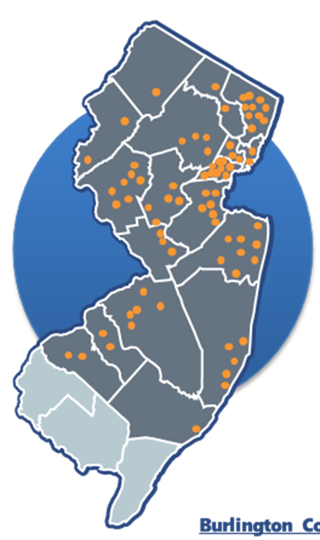
CGP&H – Administrative Agent
CGP&H serves as municipal Administrative Agent in many communities including Cranford, Edison, Bridgewater, Bernardsville, Montgomery, and Woodbridge and conducts affordable sales and rentals in towns across the state.
For Bedminster Township, we will assist in keeping the inventory of affordable units creditworthy and in compliance with the affordable housing rules, answer affordable housing questions and concerns, and work to further the goals of their affordable housing plans.
For Bedminster residents, we will work to sell and refinance their affordable units and guide them through the procedures of the affordable housing rules.

Slide 4
For Residents
If you want to Sell your affordable unit:
Intent to Sell Package - Contact CGP&H at homes@cgph.net
We have close to 1,000 people on the waiting list for Bedminster
We will refer buyers from the waiting list
Once you are under contract, you experience a fairly traditional real estate process
We will calculate the recapture amount to be paid to Bedminster
No CGP&H charge for seller or buyer
CGP&H will complete the deed restriction documents for closing
If you want to Refinance your affordable unit:
Let us know you would like to refinance - Contact CGP&H at homes@cgph.net
We will let you know the maximum amount that you can refinance for
We charge a $175 fee
We work with your lender to complete the subordination process
Other services:
Changes to deed/mortgage
Questions about affordable housing rules

Slide 5
List of Pre-approved Improvements for an Affordable Sale
Air Conditioning (Village Green only)
Carpeting (neutral color)
Ceiling Fans
Flooring in Kitchen or Bathroom
Washer, Dryer, Refrigerator & Dishwasher
WHAT WE NEED TO GIVE CREDIT:
Store receipts with the unit address and homeowner name.
10% per year depreciation is deducted off the original amount.

Slide 6
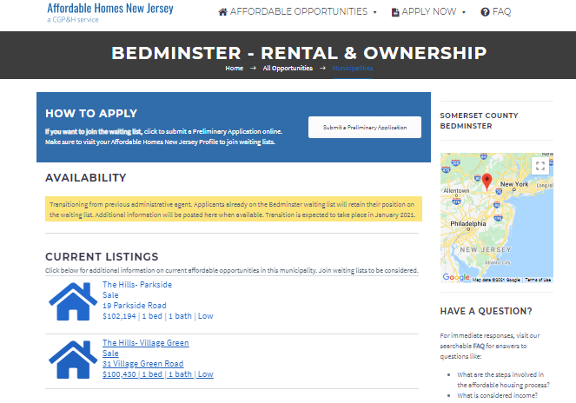
How to Join the Bedminster Waiting List
Apply on-line at AffordableHomesNewJersey.com
Applicants without web access or email address may call 609-664-2769 ext 5.
Applicants can submit updates to income, etc. on-line.
Applicants will be notified via email when we get to their name on the waiting list.

Slide 7
Questions?
Heather Mahaley, PP, ACIP
CGP&H, Senior Planner/Project Manager
hmahaley@cgph.net
609 642-4707
1249 South River Road, Suite 301
Cranbury, NJ 08512-3633
Company Website: www.cgph.net
Affordable Homes For Sale and Rent: www.affordablehomesnewjersey.com
General Inquiries: homes@cgph.net

